Slide 1
An Introduction to Neural Networks
Satchit Chatterji
MSc Artificial Intelligence
University of Amsterdam satchit.chatterji@gmail.com
Adapted from ISOTDAQ 2022
Notes:
Introduce myself
How many of you have used ….
Know what an nn is already
Understanding the nature of human intelligence. We are symbolic creatures that can string together symbols to make symbolic stories, despite everything in our heads being just these strange, complicated series of cells with distributed information flowing through in the form of chemistry, electricity and black magic.
During the next hour, I’ll be your guide to the realm of artificial abstractions or approximations of neurons, unsurprisingly called artificial neural networks, and try and answer why, as physics students, may want to use them for trigger and data acquisition. You can also ask questions whenever you have them during the lecture. There’s a lot to cover, so strap in! Let me know if I’m going too fast.

Slide 2
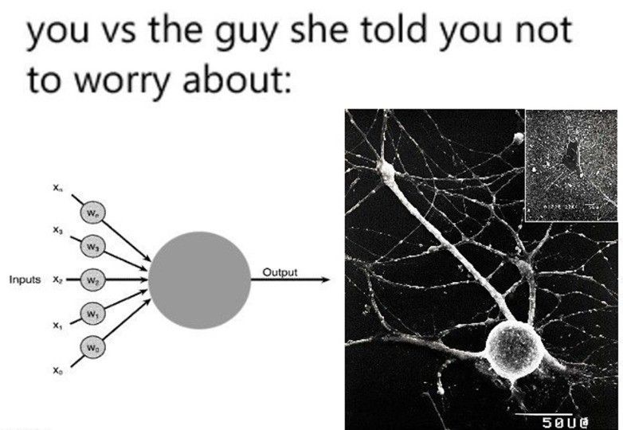
Artificial vs Biological NNs
ANNs initially inspired by the brain: Alexander Bain (1873), William James (1890) Electrical connections/flow of neurons result in thought and movement McColloch & Pitts (1943) Modern mathematical “artificial” NN models (not the only neural network model!) Rosenblatt (1958)
Description of the perceptron Rumelhart, Hinton & Williams (1986) Multi-layer perceptrons and error backpropagation (learning principle)
Modern day: - ANNs used everywhere for everything! - Simplified, abstracted version of “synaptically”-connected “neurons” - Biologically implausible
Image source: linkedin.com/company/deeplearningai

Slide 3
Building a Neural Network
From Scratch (intuitively)
Notes:
Timestamp: 00:10

Slide 4
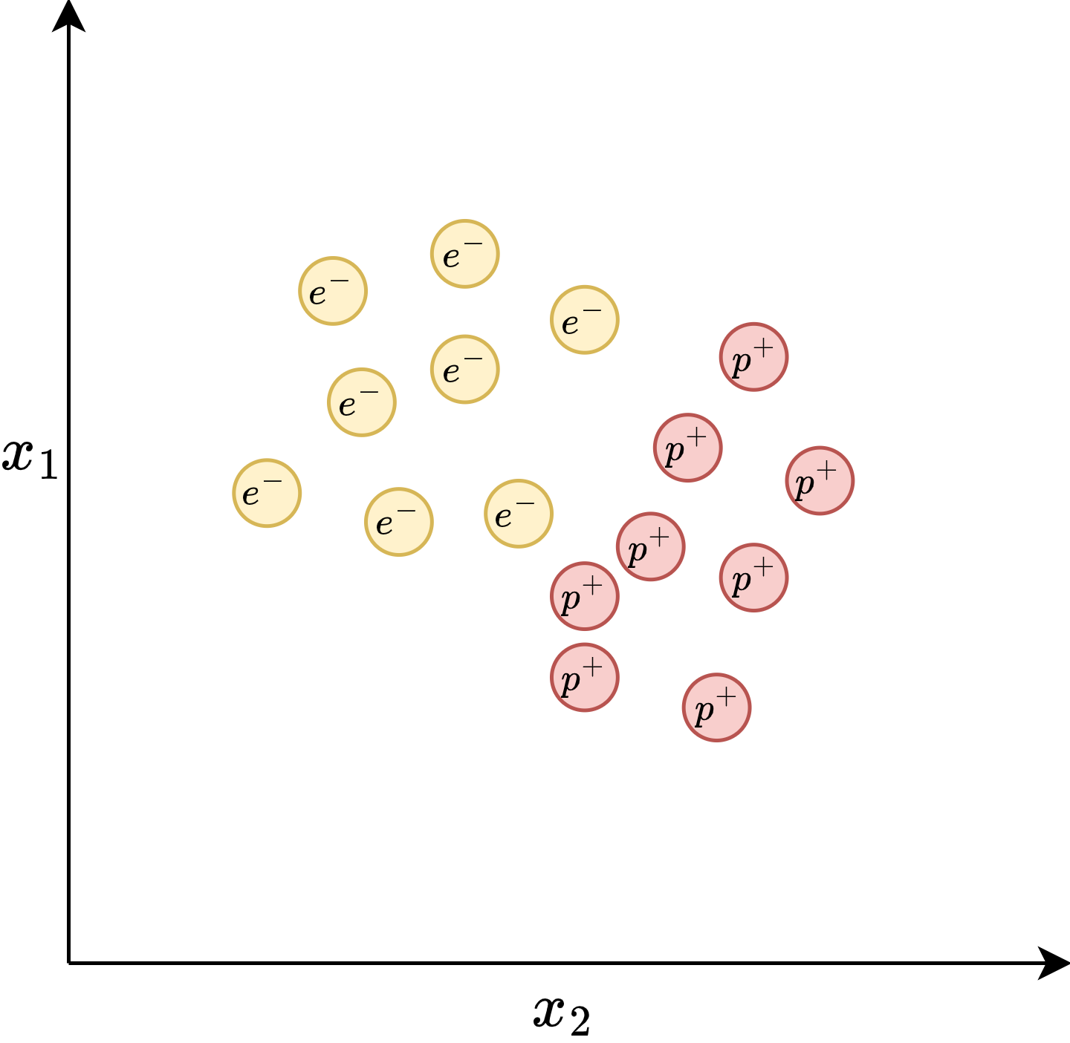
Notes:
x1 and x2 are the variables that relate to these classes, and the particles lie on the observations we make on them. Maybe masses, maybe charge, maybe opinions on how physicists feel about them.

Slide 5
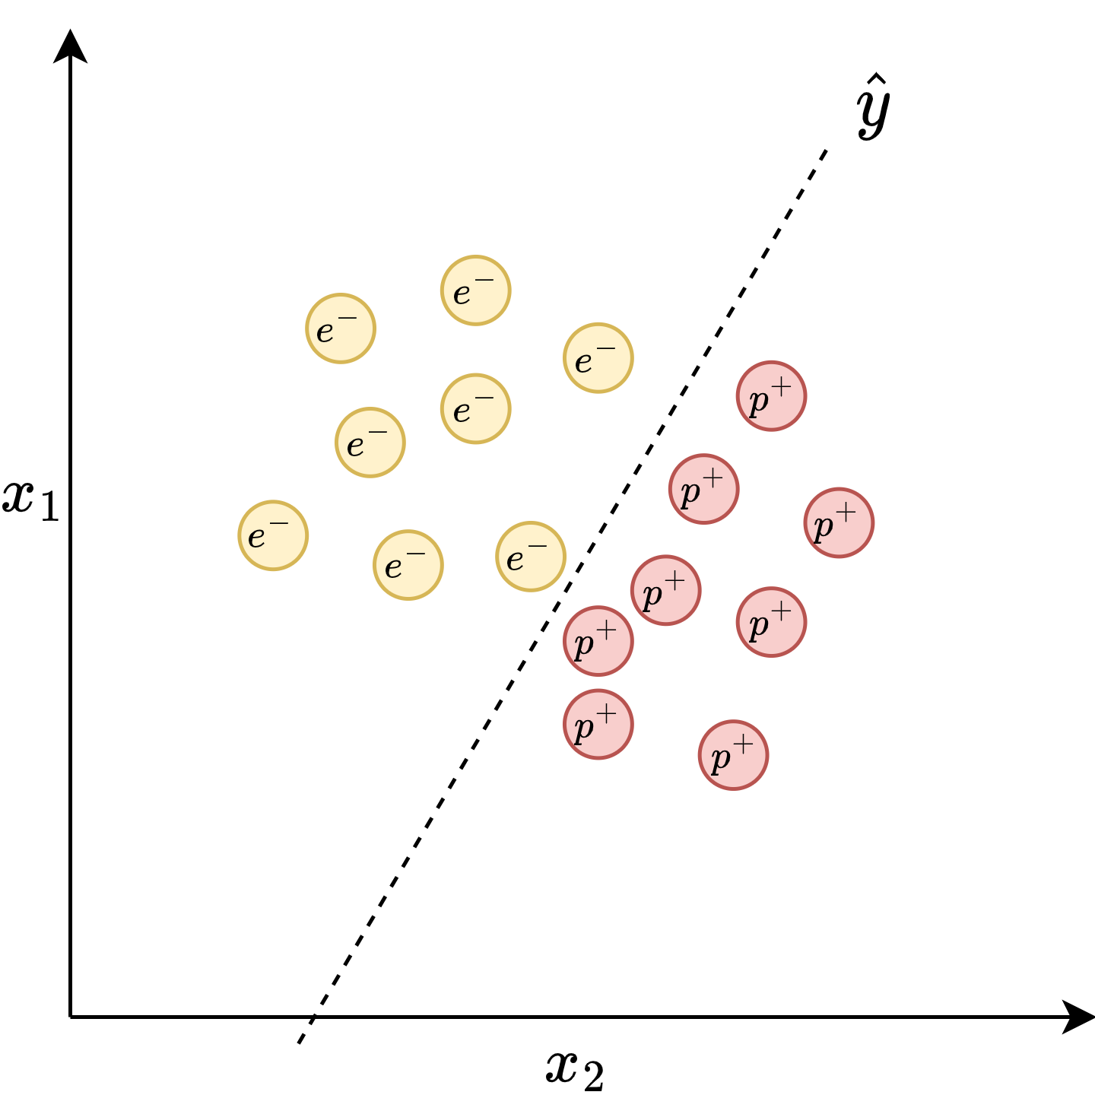
Classes are “linearly separable”

Slide 6
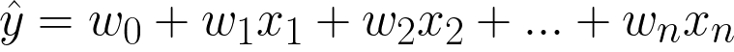
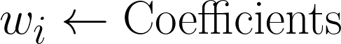
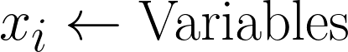
Notes:
y hat can be modelled as a simple line

Slide 7
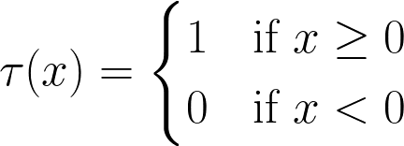
Notes:
Let’s say if y is greater than 1 it’s an electron, else a proton. So we define this “wrapper function” that checks if something is above or below the line. I’d like to now propose a diagrammatic representation of the calculation, since what is a technical lecture without a good diagram?

Slide 8
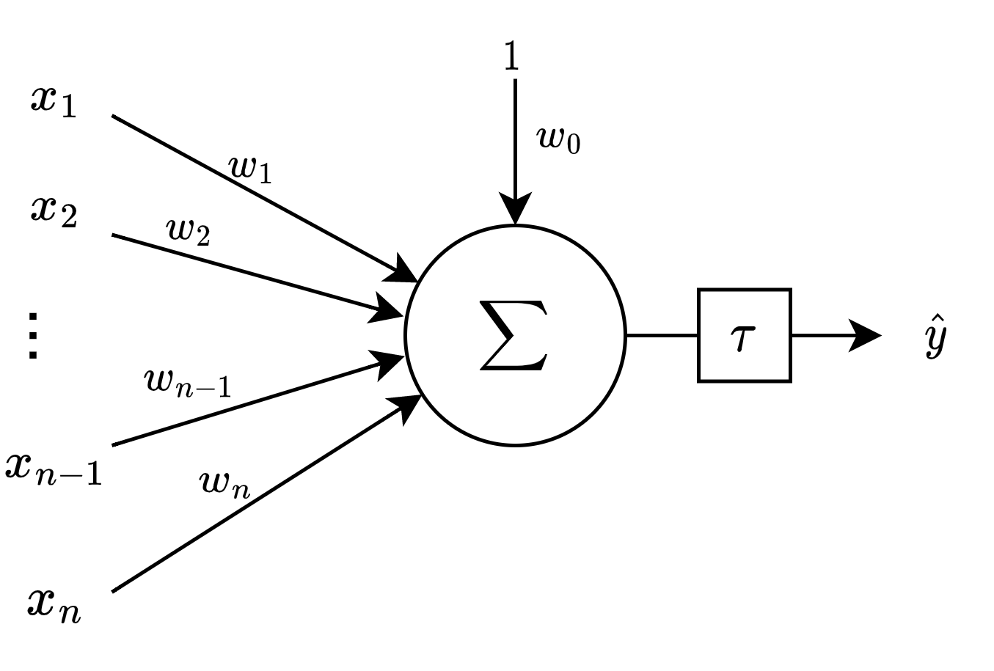
Notes:
Ha! I’ve tricked you! This isn’t just a simple sum, it’s…

Slide 9
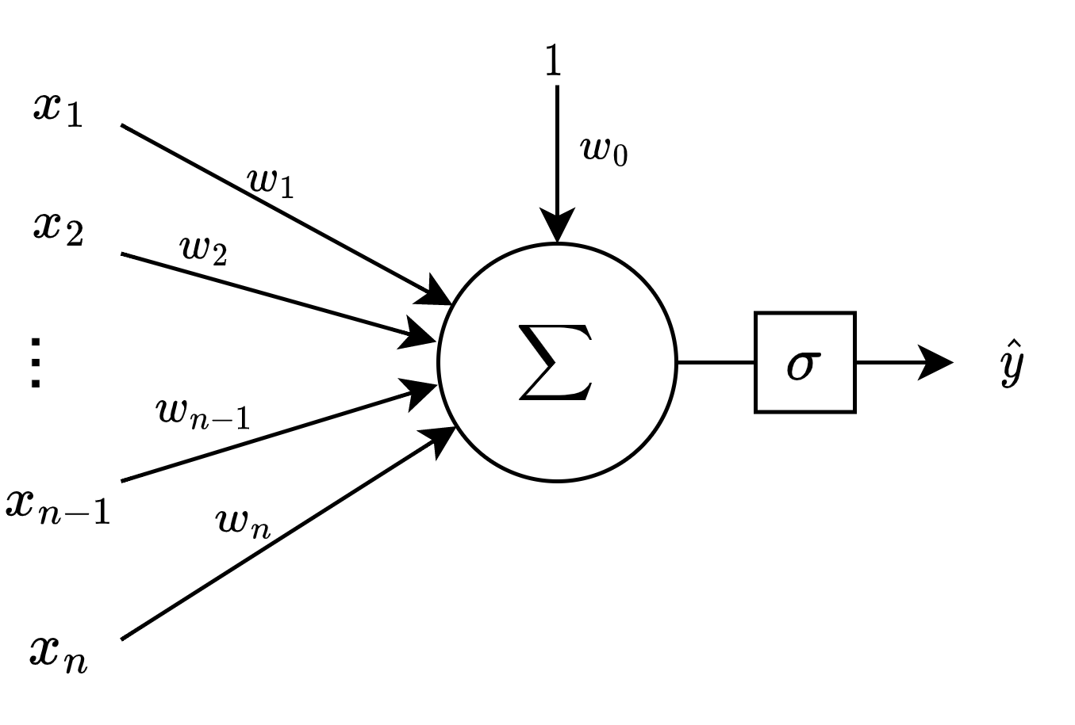
The “Perceptron”
Generalized “activation function”
The modern notion of a single “neuron”
BUT: Only works on linearly separable classes

Slide 10
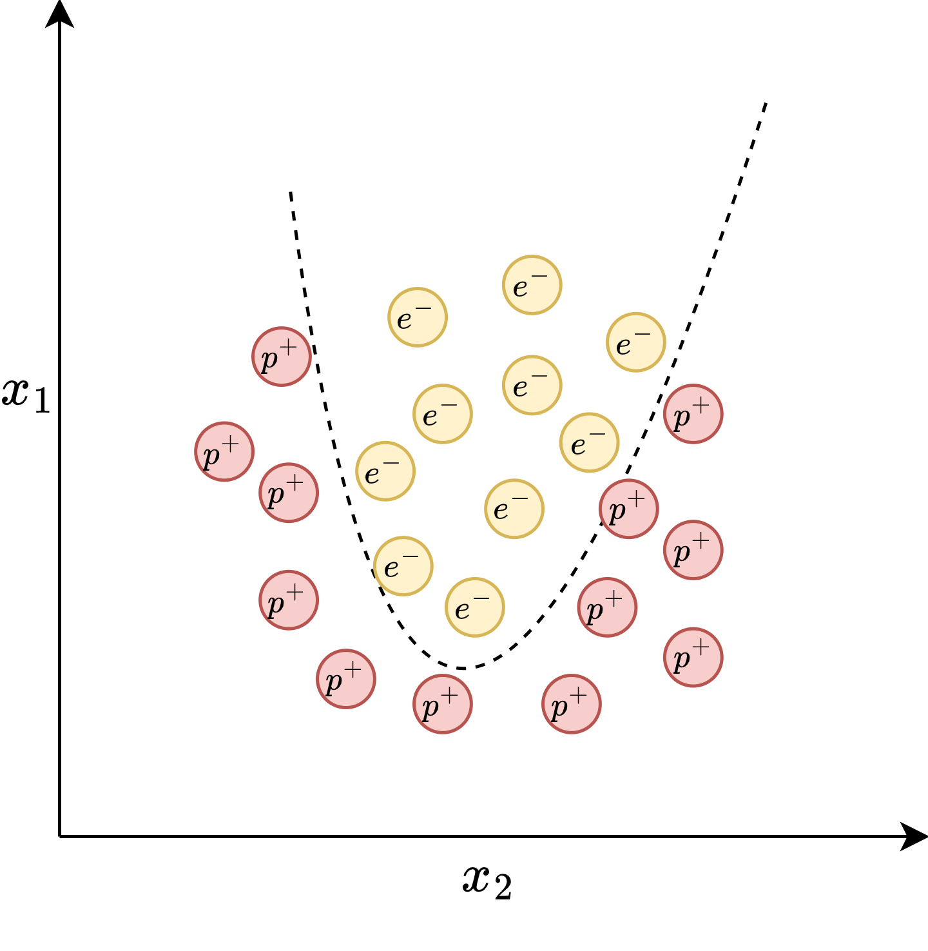
Notes:
In reality we often get things that are not approximable with lines. What if you want to model a more complex function?

Slide 11
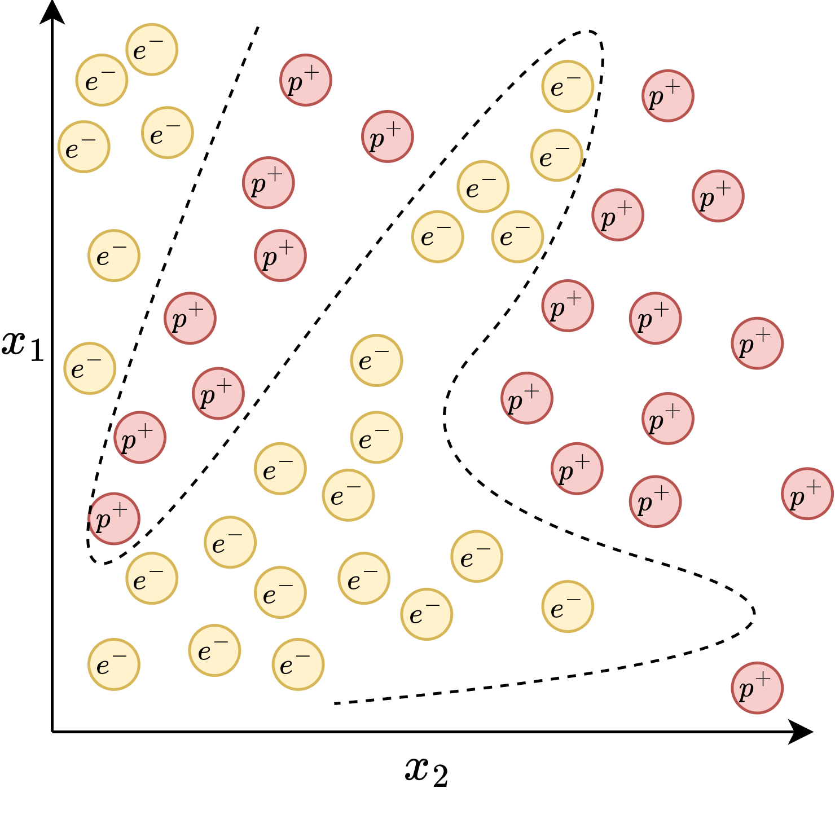

Slide 12
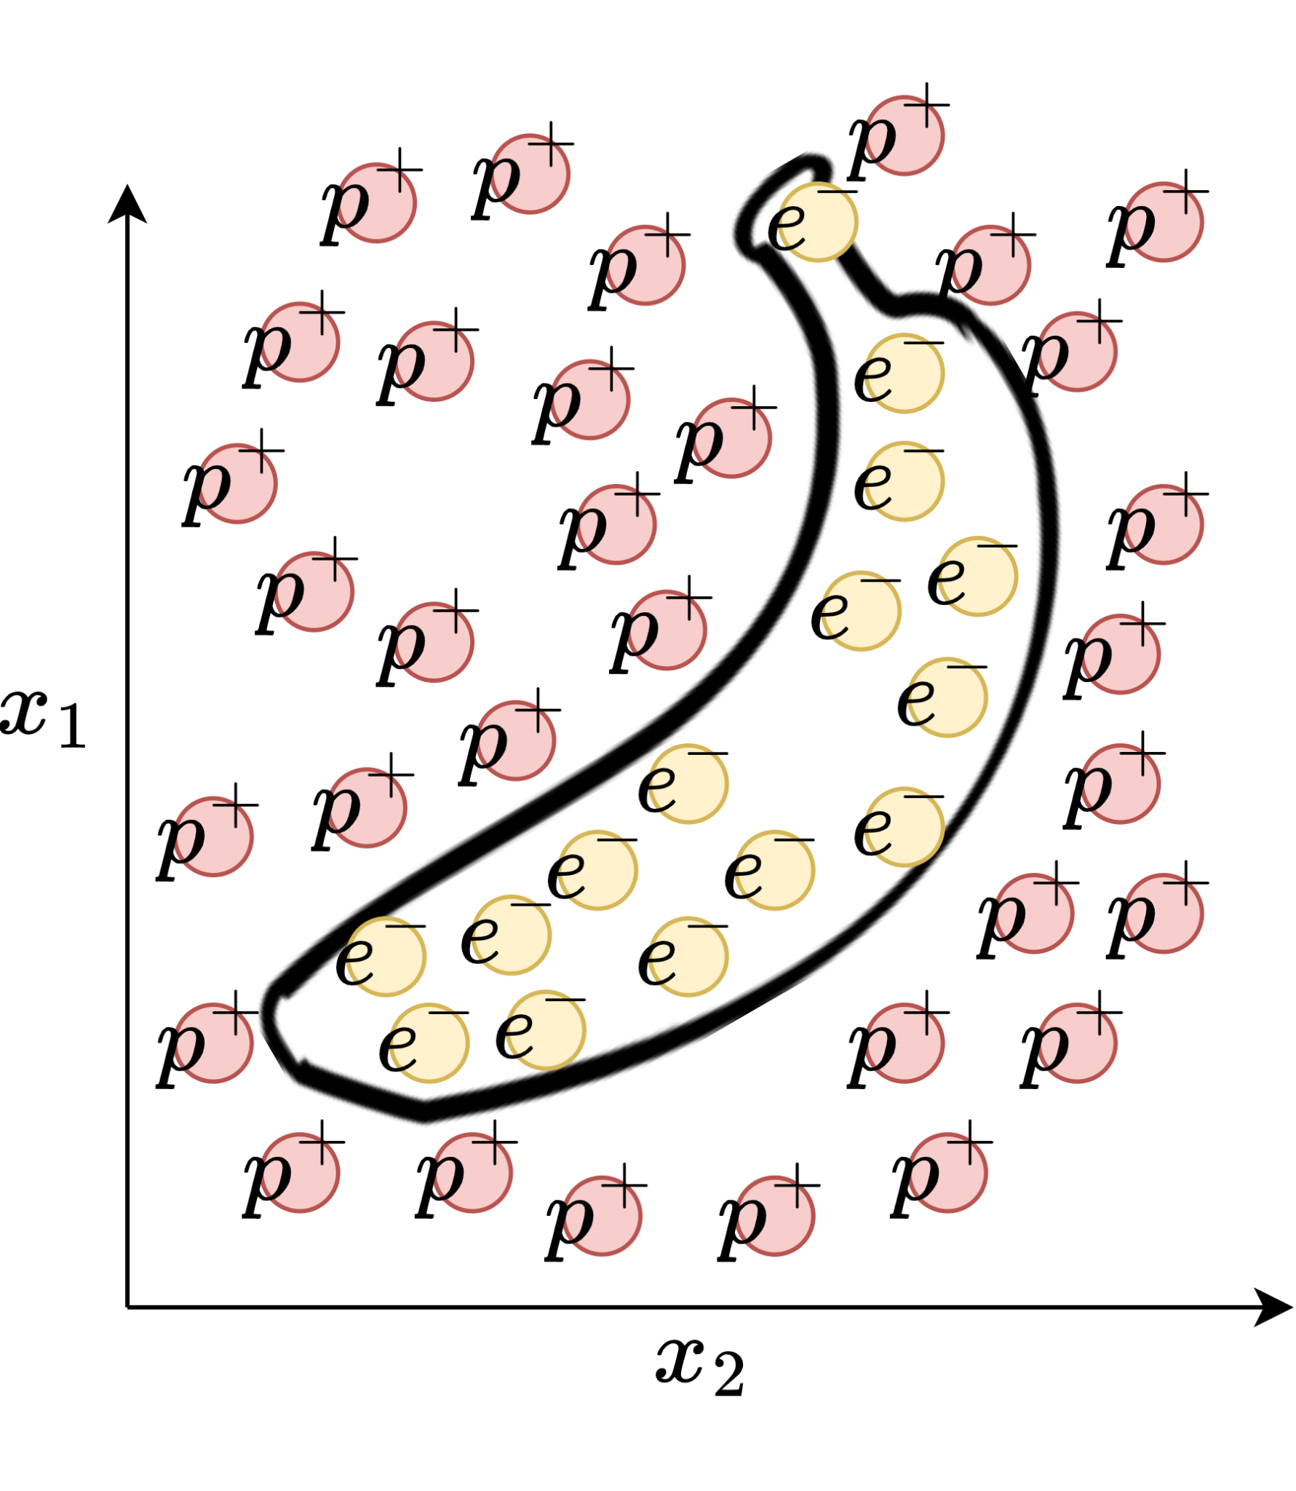

Slide 13
Notes:
In reality we often get things that are not approximable with lines. What if you want to model a more complex function?

Slide 14
…
Notes:
Let’s get back to the perceptron. What if we could chain them together in something like a layer? Maybe we could approximate little bits of our complicated functions as little lines and combine them to get a sort of complicated piecewise function?

Slide 15
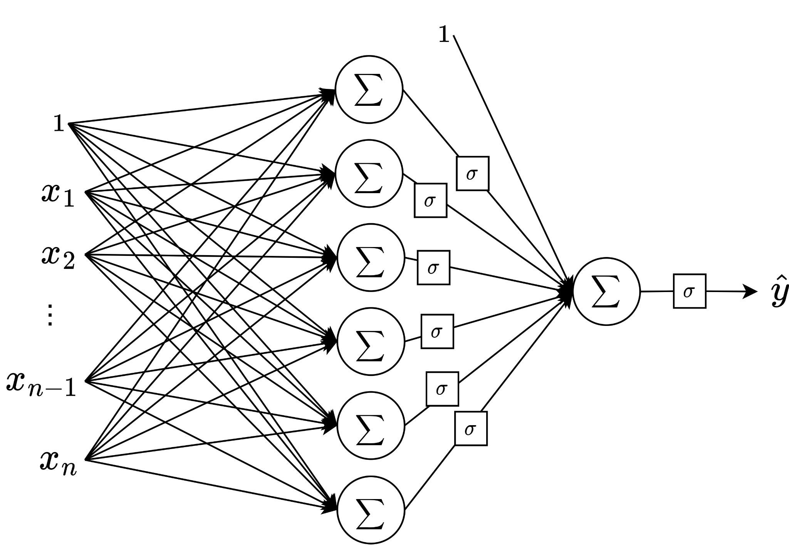
Notes:
Let’s do just that. For the sake of clarity, I’ll remove the redundant nodes of the graph, remove the weight labels and add in another perceptron at the end to sum up our tiny linear approximations. This diagram may look familiar to some already. Ha! I tricked you again!

Slide 16
Multi-layer Perceptrons (MLPs)
Notes:
Okay now let’s back to how we can implement this mathematically and perhaps more efficiently

Slide 17
Notes:
Back to a single neuron. Can someone suggest a more compact representation of this?

Slide 18
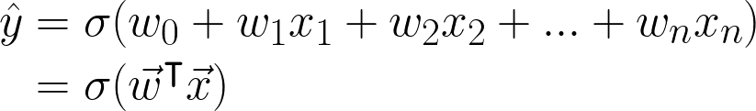
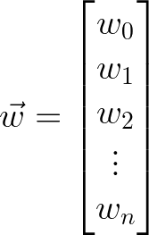
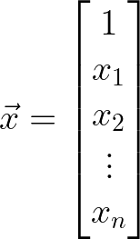
Notes:
Now to add in some buzzwords

Slide 19
“Bias”
“Activation”
“Activation function”
“Weight vector”
“Feature vector”

Slide 20
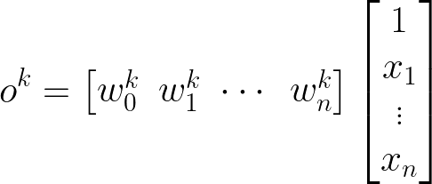
Activation/ output of neuron k
K "hidden” neurons in layer L

Slide 21
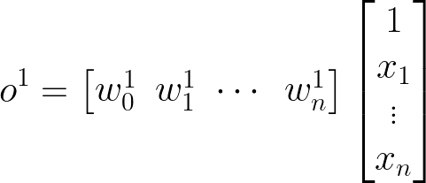

Slide 22
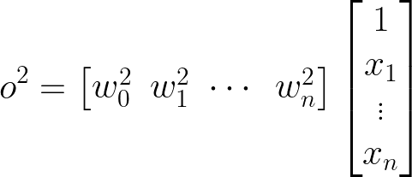

Slide 23
Notes:
Can you see what’s gonna happen next?

Slide 24
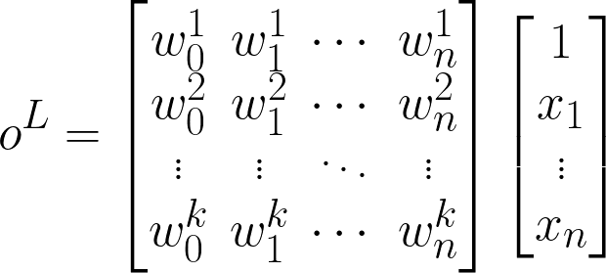
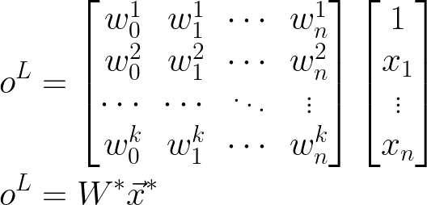

Slide 26
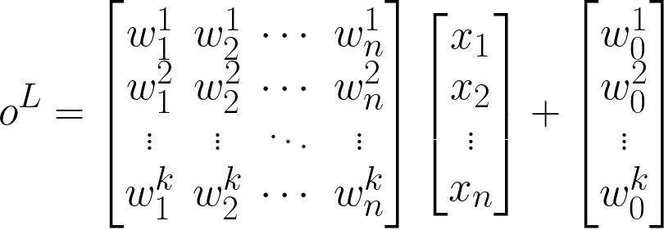
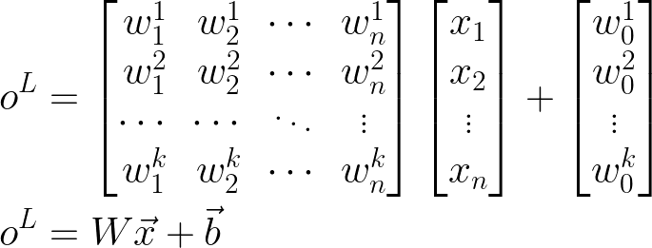
Most common way of writing out the activation of a layer of an MLP

Slide 27
Notes:
We’re still missing a vital component though. Any ideas?

Slide 28
Notes:
Exactly, the activation function.

Slide 29
Notes:
Exactly, the activation function.

Slide 30
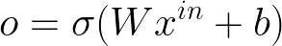
The output of each layer is the product of its weight matrix and the input vector plus its bias vector, all wrapped in a non-linear activation function.
Notes:
What this means is

Slide 31
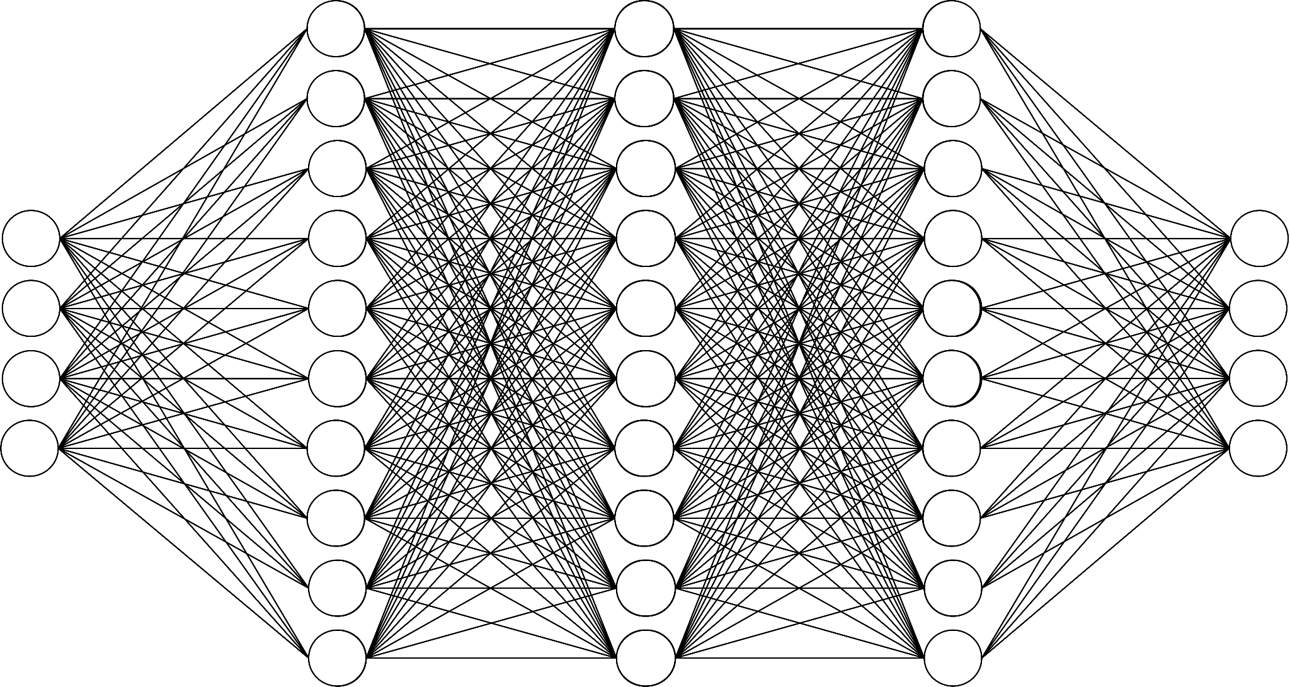
⇒ Inputs
⇒ Outputs

Slide 32
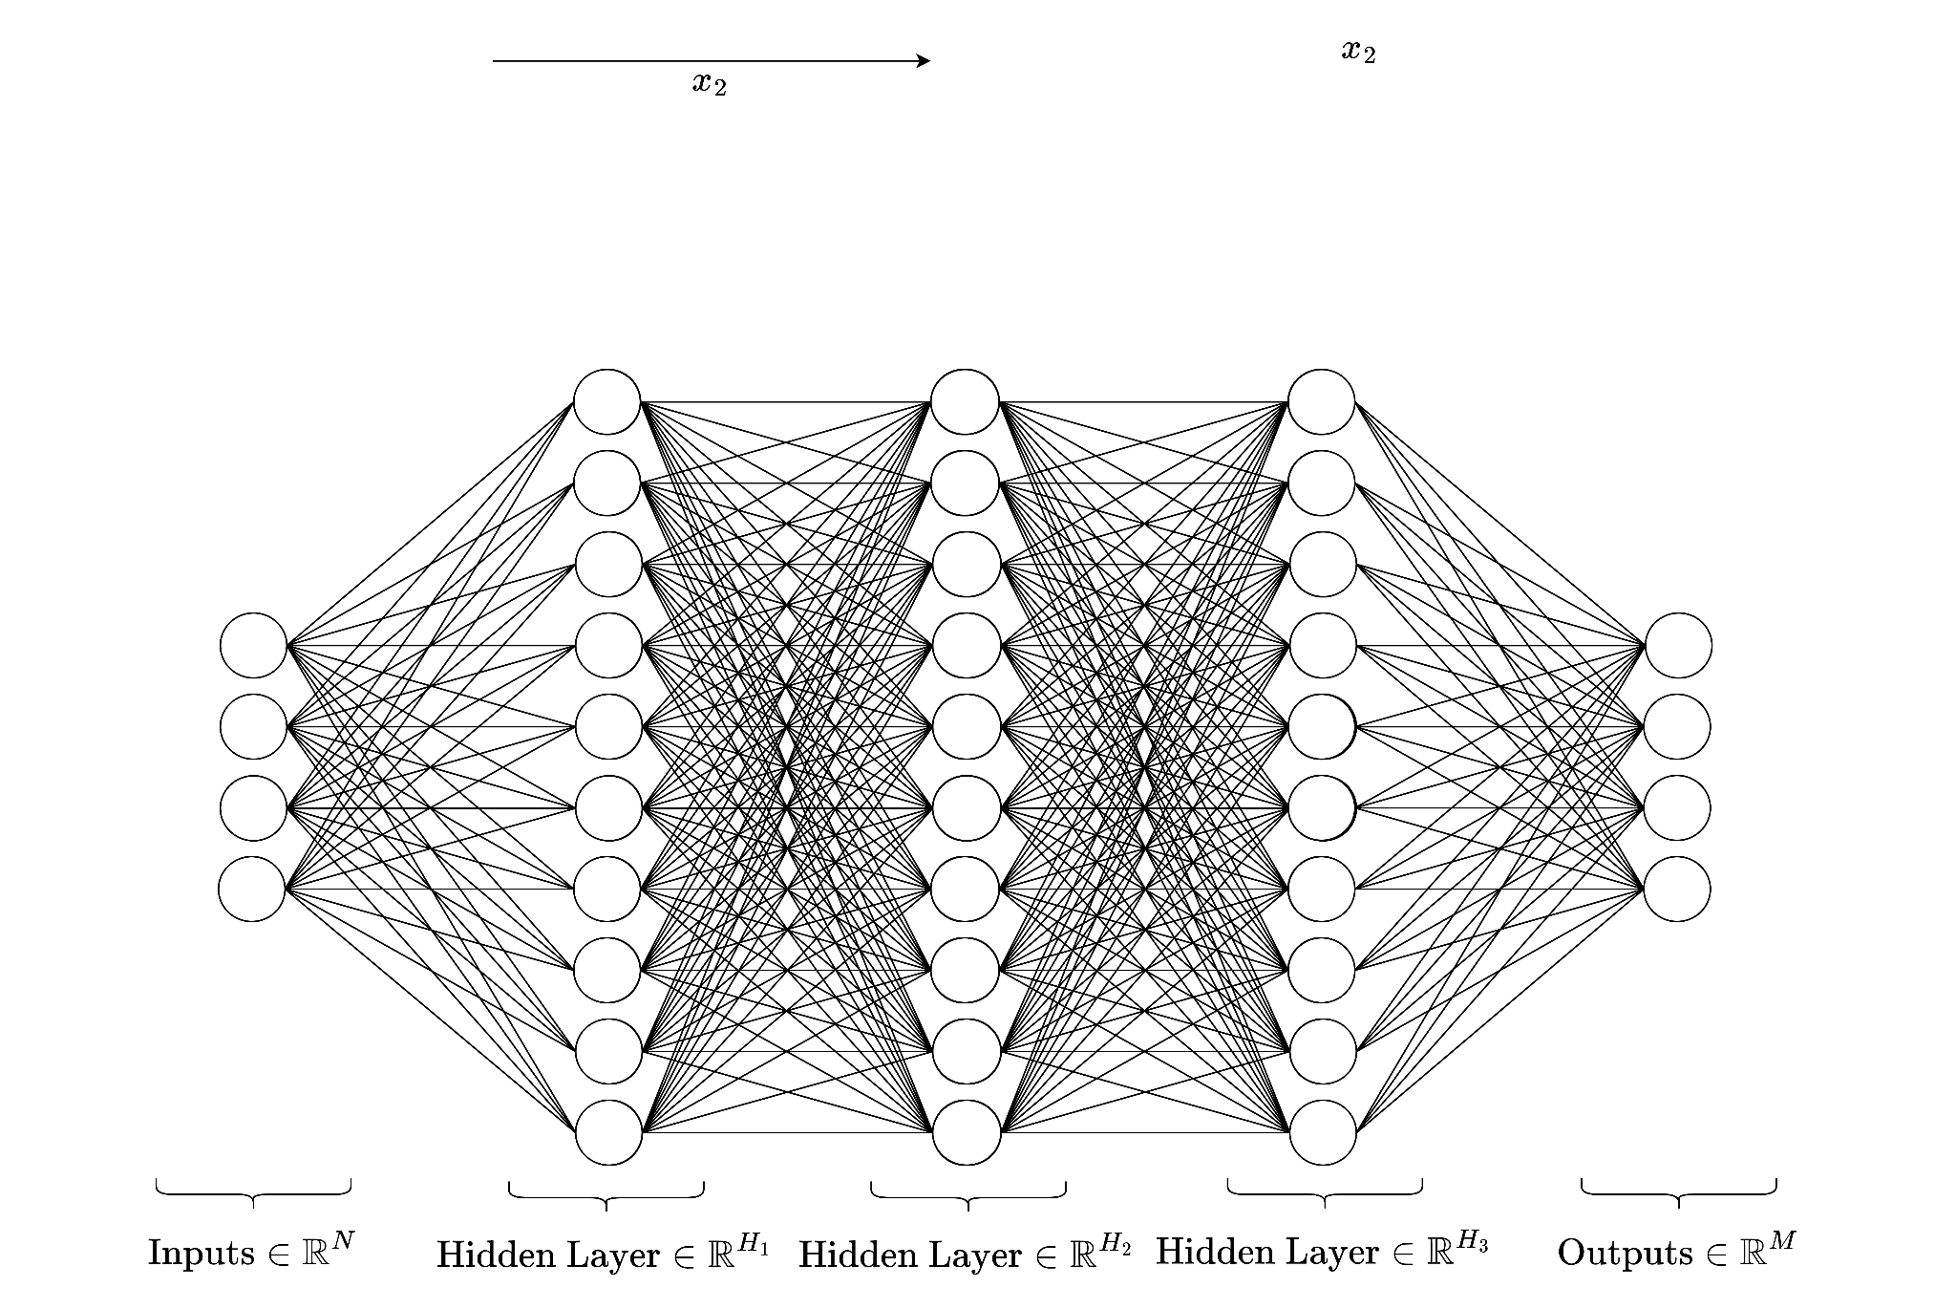

Slide 33
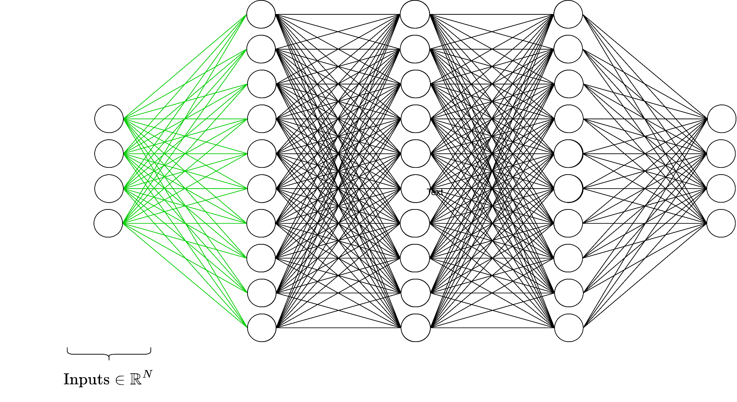

Slide 34
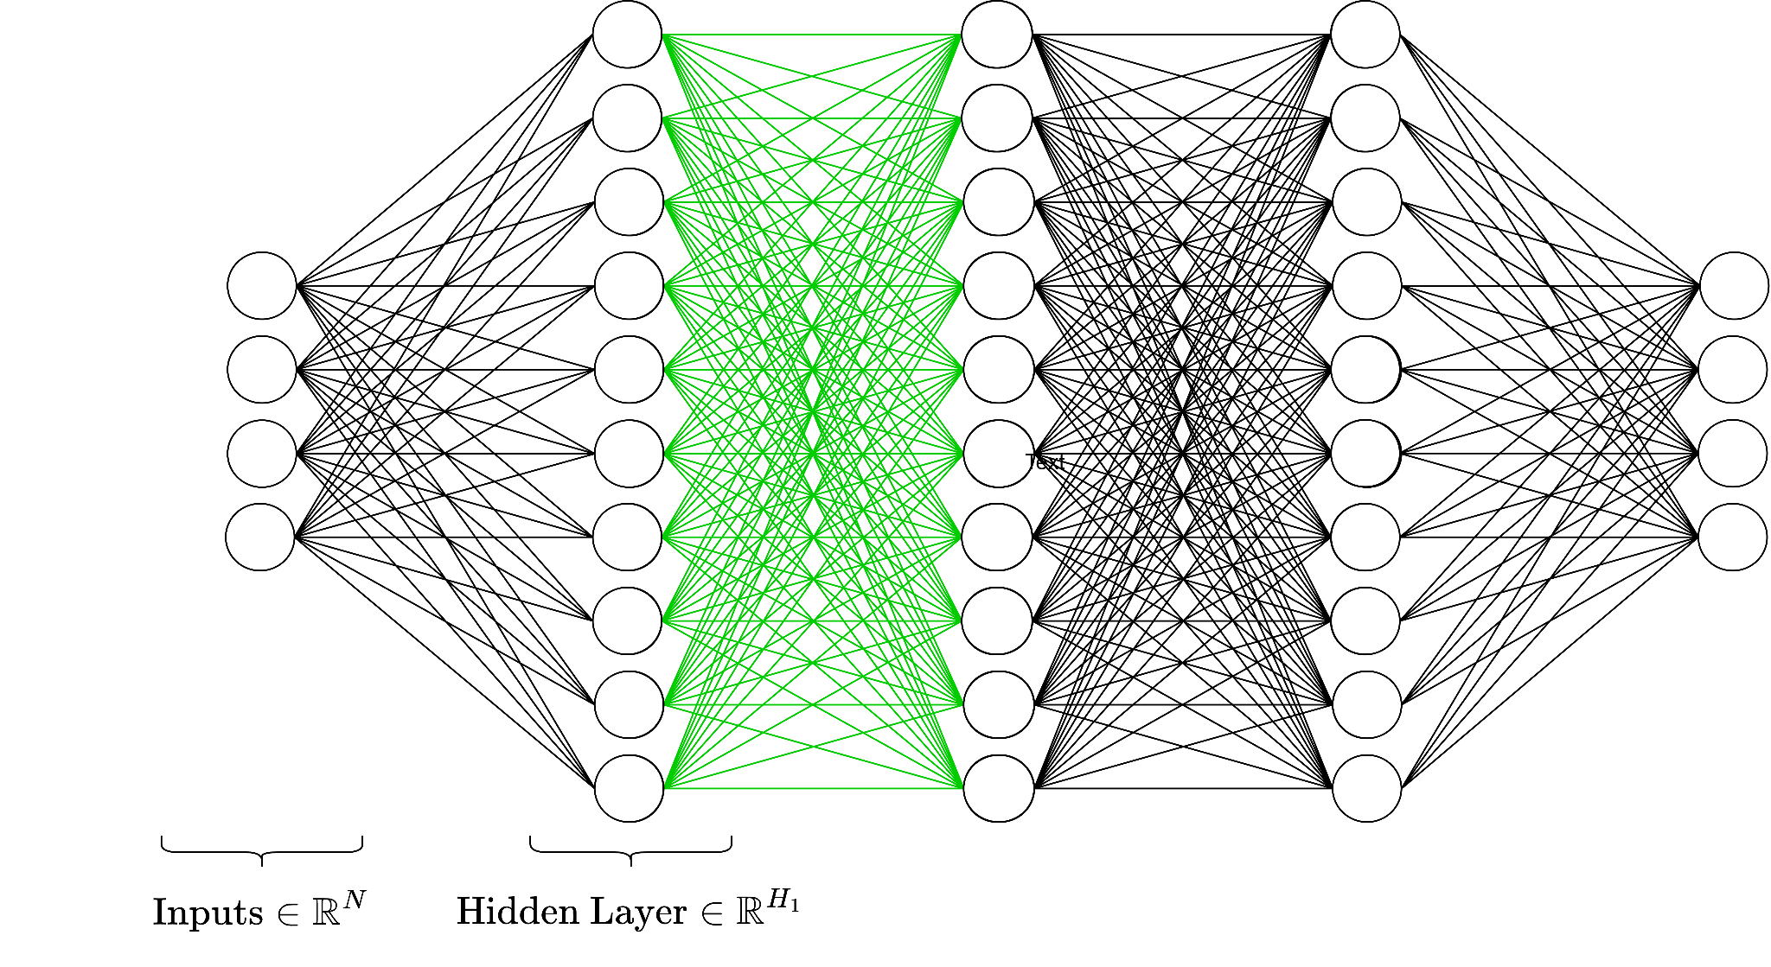

Slide 35
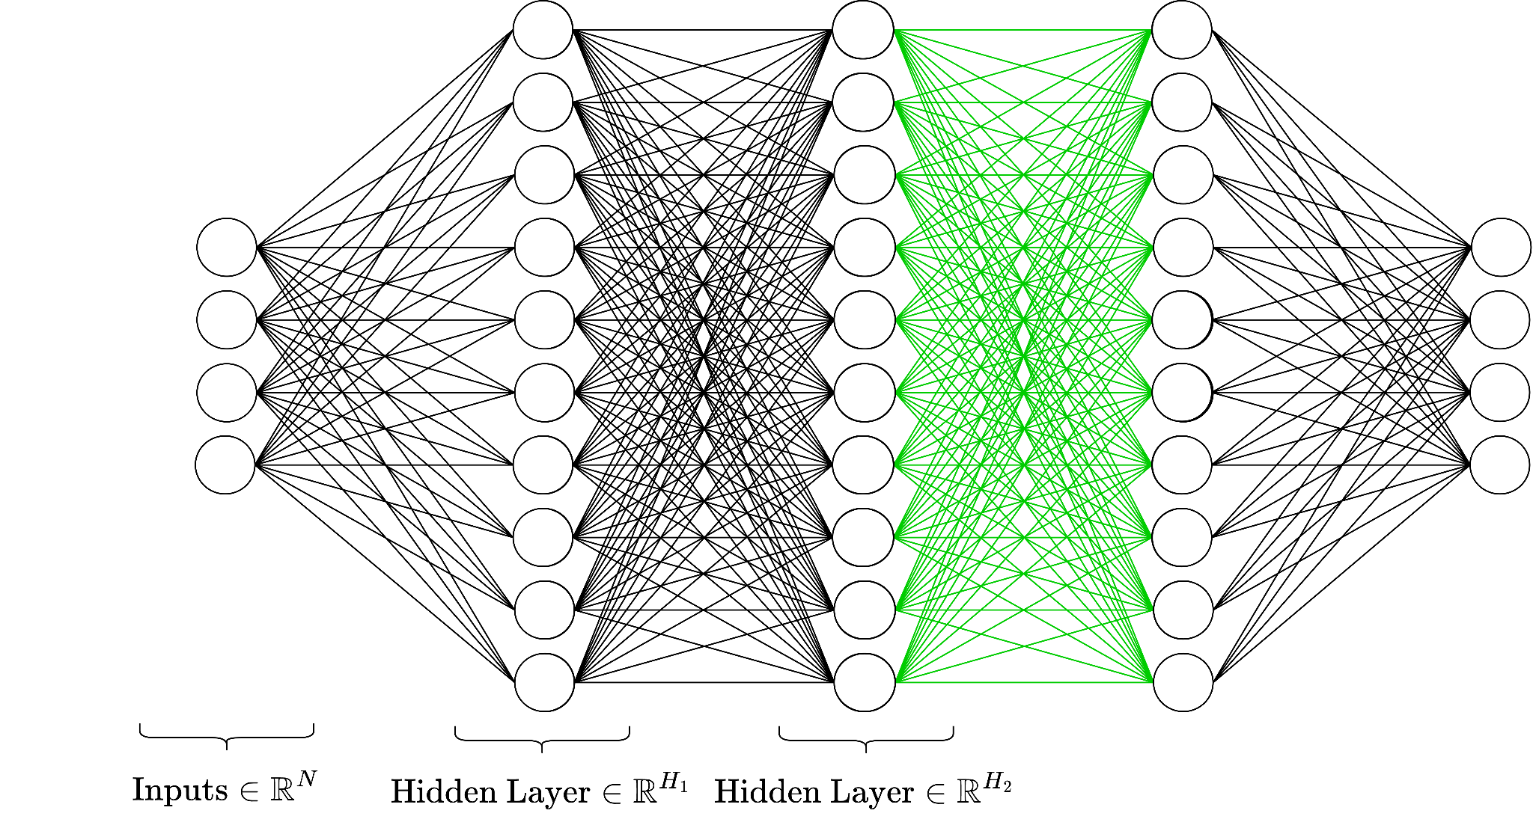

Slide 36
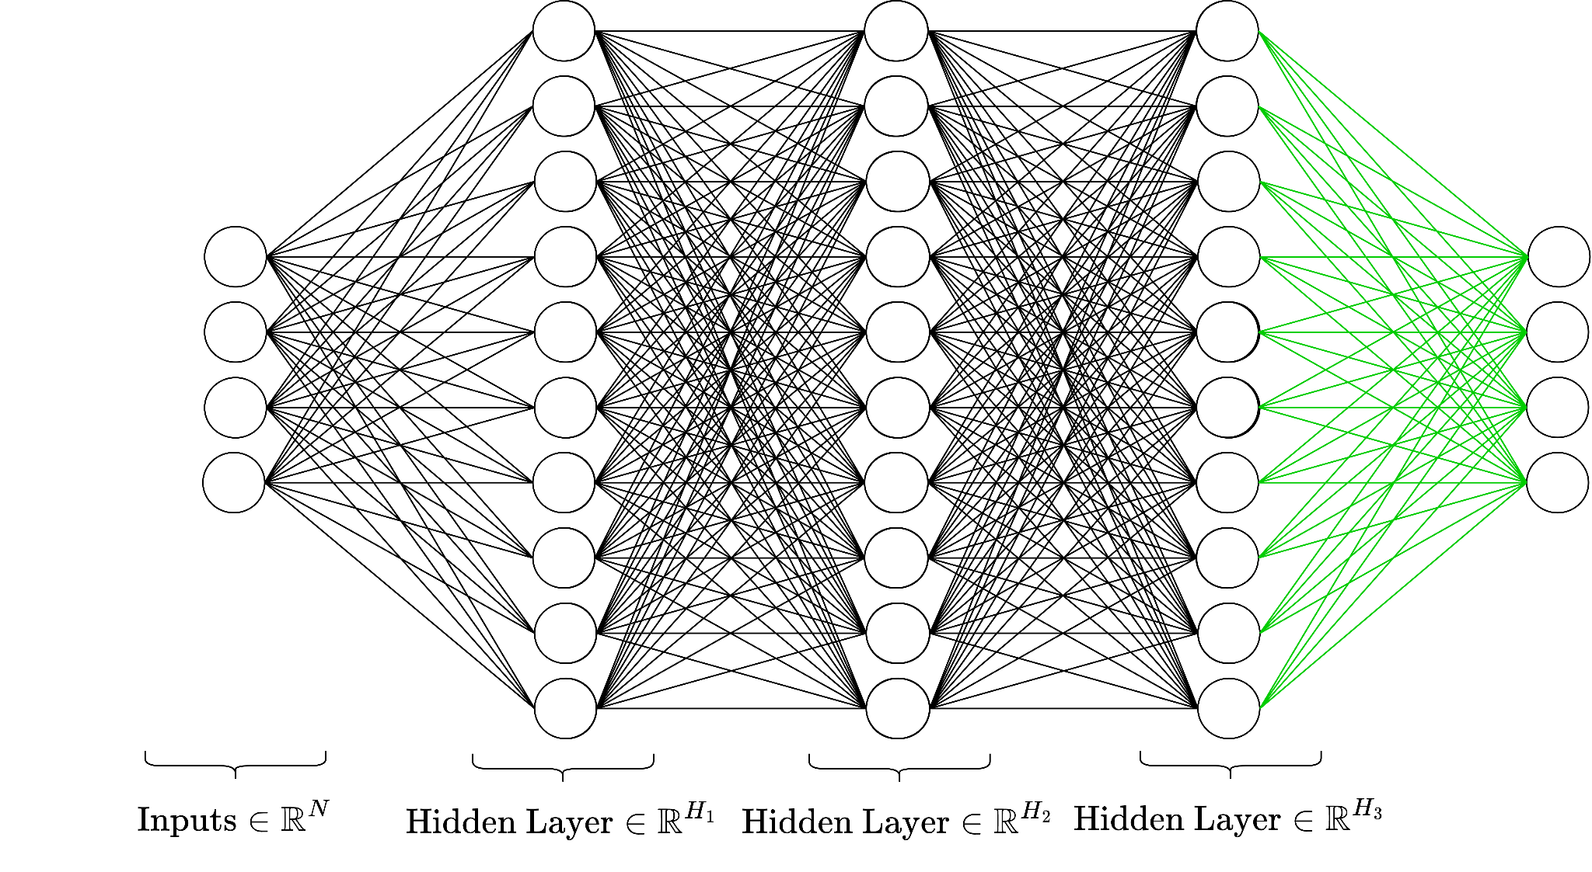

Slide 38
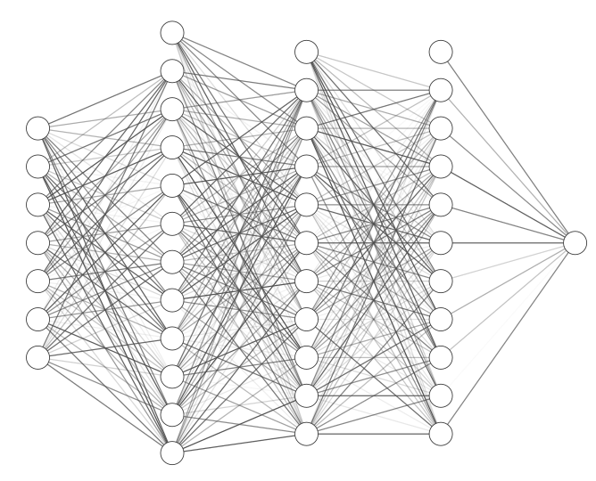
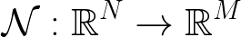

A multi-layer perceptron is a series of affine transformations of an input vector, each of which is wrapped in a non-linear activation function.
(Translation: an MLP is a fancy function)
Notes:
Okay just to recap

Slide 39
A Note on Nonlinearity

Slide 40
A Note on Nonlinearity
Without a non-linear activation function, a series of linear transformations would result in just a linear transformation of the input to the output.
We would still be stuck in the land of linear separability!

Slide 41
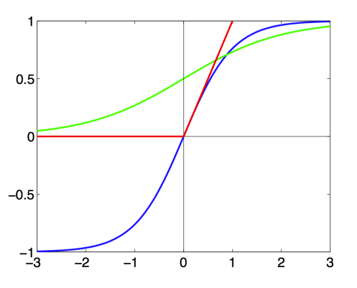
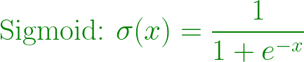
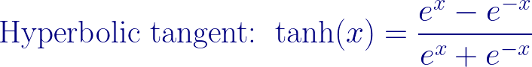
Common nonlinear functions

Slide 42
Backpropagation

Slide 43
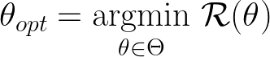
Implementing learning: Gradient descent
Given:
Family of parameters (e.g. possible weights of a NN)
Differentiable risk function
Goal:
Backprop: A specific implementation of GD, where errors are passed backwards through layers

Slide 44
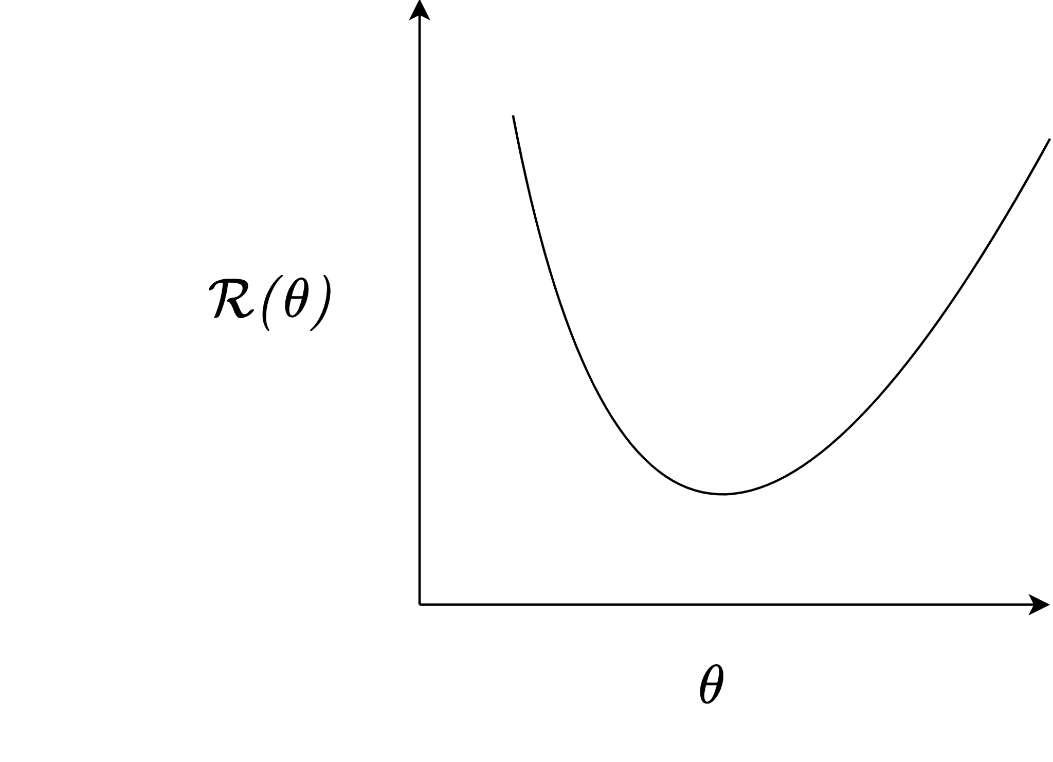
Gradient descent

Slide 45
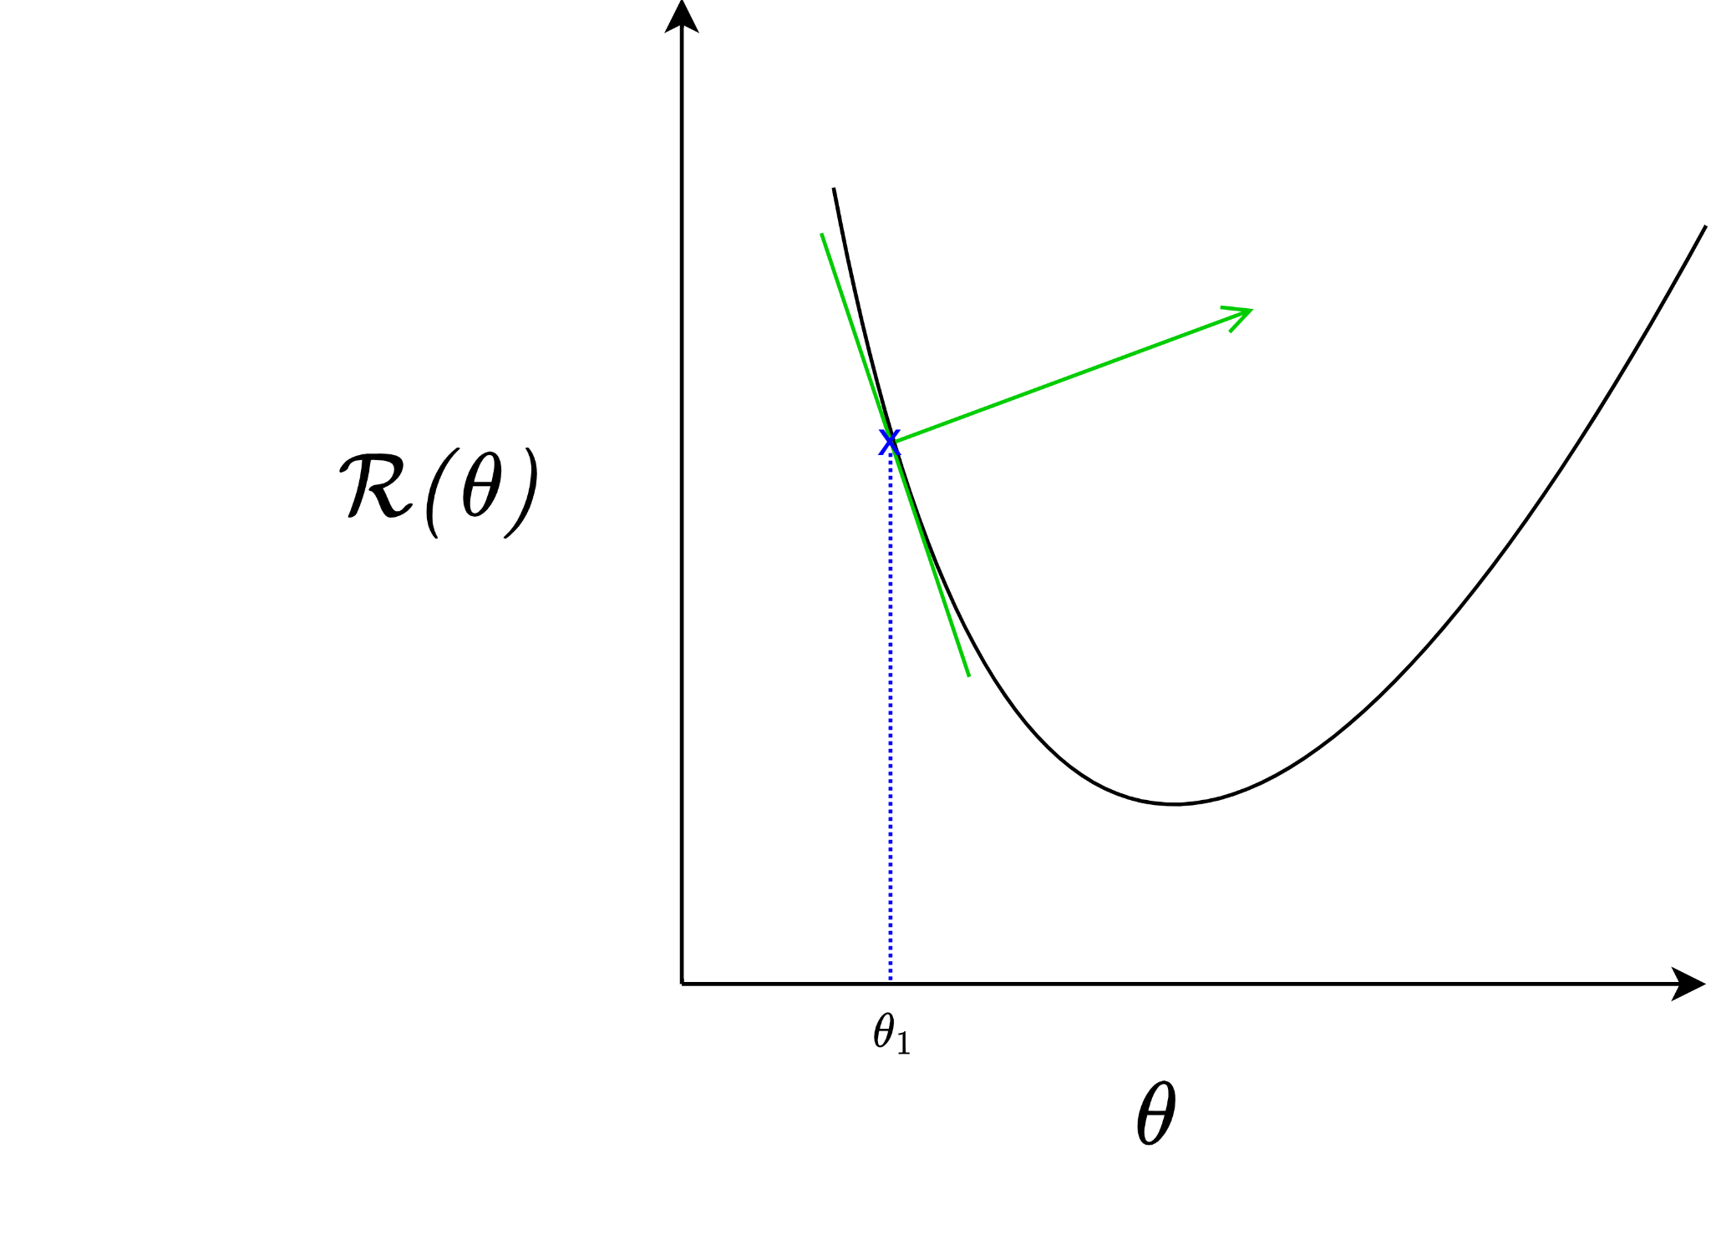
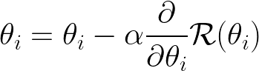
“Learning rate”
“Guess”

Slide 46
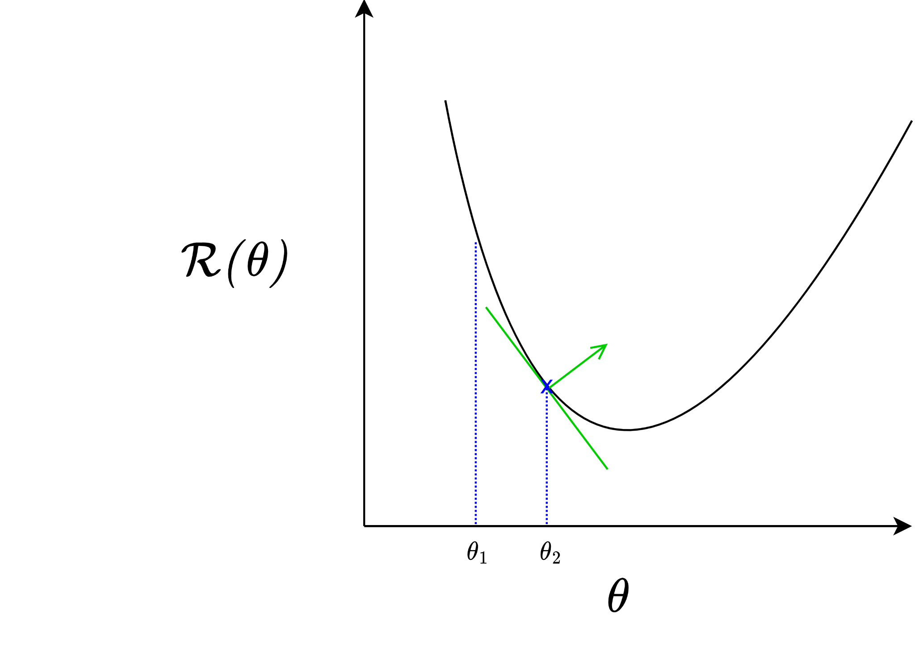

Slide 47
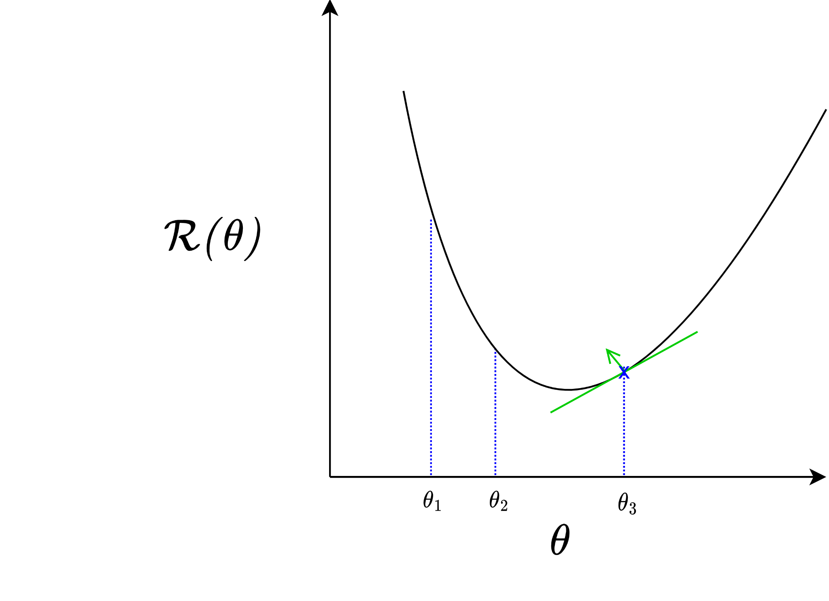

Slide 48
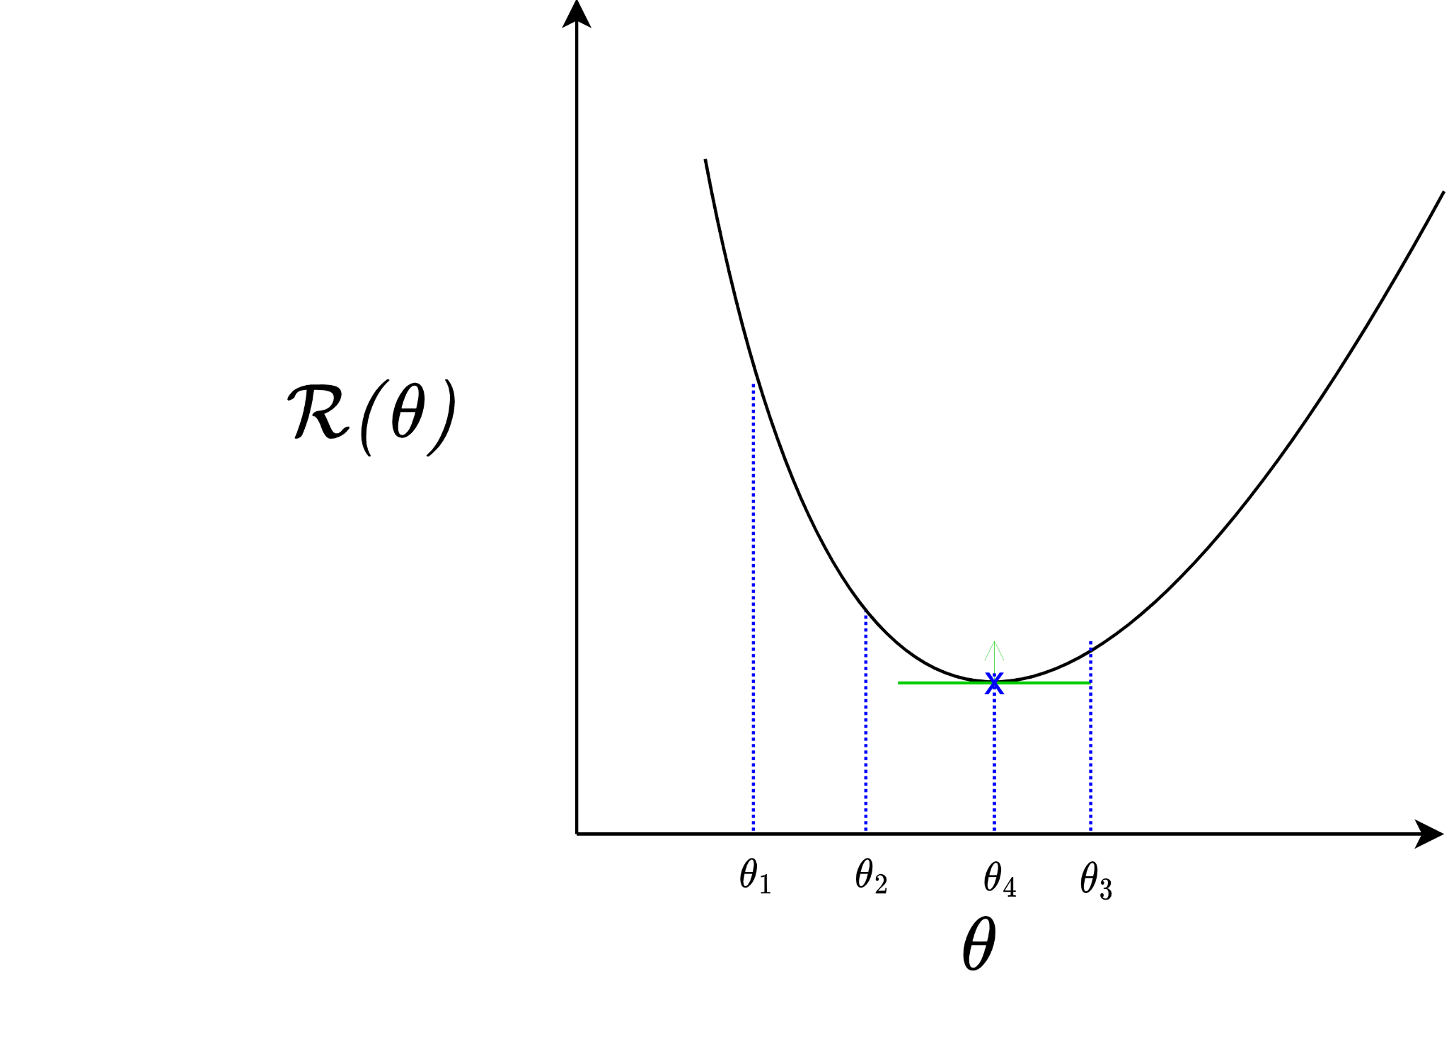
Converges to local minima

Slide 49
Optimizers
Stochastic/Mini-batch GD: Speed improvement! Perform backprop on batches of training samples instead of all at once - Reduces the number of expensive backward passes
Optimizers determine exactly how gradient descent is implemented - Stochastic Gradient Descent (most common) - Adam - RMSProp

Slide 50
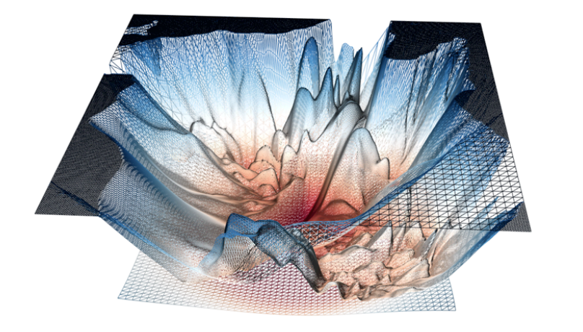
A “real” loss landscape:
Many (many many) local minima
Saddle points
http://www.telesens.co/2019/01/16/neural-network-loss-visualization/

Slide 51
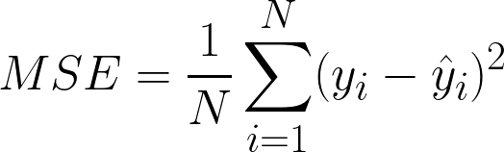
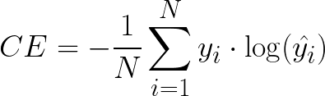
Loss functions
Depends on the task!
Mean Squared Error Used for e.g. regression tasks
Cross Entropy Used for e.g. classification tasks
Define your own! Note: Must be differentiable for gradient descent based methods

Slide 52
What NNs can and can’t do

Slide 53
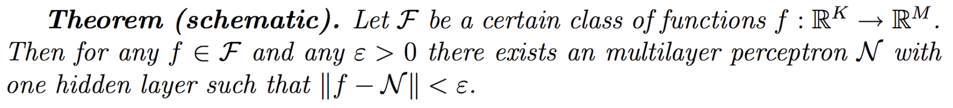
Universal Approximation Theorem
⇒ We can approximate any function we want with a one-layer MLP!
More effective with more layers than just one (“deeper” networks)
Easier said than done in practice
Schematic borrowed from Jaeger, H. (2022) Neural Networks Lecture Notes, https://www.ai.rug.nl/minds/uploads/LN_NN_RUG.pdf
Collection of proofs: https://ai.stackexchange.com/questions/13317/where-can-i-find-the-proof-of-the-universal-approximation-theorem

Slide 54
Why function approximation?
Pattern recognition
Time series prediction
Denoising, restoration
Pattern completion
Data compression
Process control
Classification and regression
Image and speech recognition
Natural language processing
Recommender systems
Anomaly detection
Robotics and control systems
Generative modeling
Reinforcement learning
Drug discovery and bioinformatics
...

Slide 55

Where NNs thrive
> Statistical/correlation inference needed
> There exists a lot of good quality (labelled) training data
> Parallelizable training and deployment
> Tasks without expansion (input-output fixed)
> Specialized tasks
> Good in-range performance IRL
https://lasp.colorado.edu/home/minxss/2016/07/12/minimum-mission-success-criteria-met/

Slide 56

Limits of NNs
NO.
> No causal relations possible (yet)
> Very data hungry - “Garbage in, garbage out”
> Often expensive to train (money & time)
> Nonextensible and specialized to a range and task - One more ouptut → finetune/retrain the entire network - Undefined behaviour on out-of-domain test examples
NO MOAR DATA.
https://knowyourmeme.com/memes/grumpy-cat

Slide 57
Families of Neural Networks
Notes:
Timestamp: 00:25

Slide 58
Multi-layer Perceptrons
Useful for static input-output relations
More hidden layers ~ better approximation of more complicated functions
Quick to design and implement

Slide 59
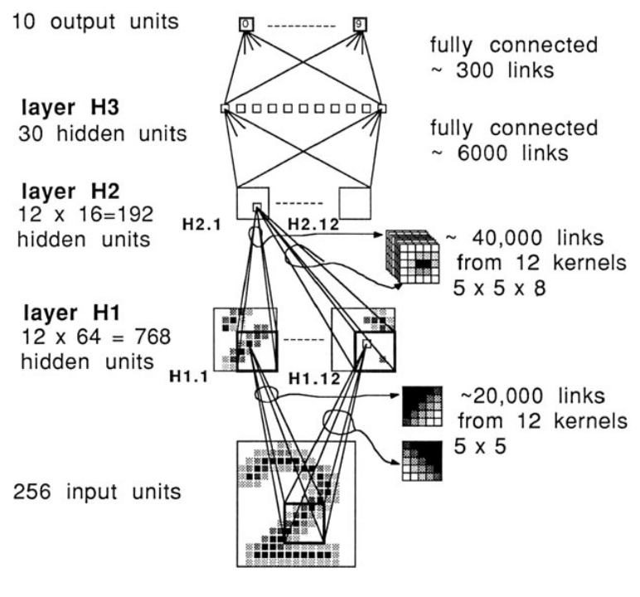
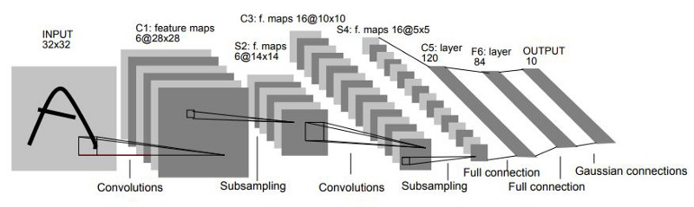
Convolutional Neural Networks
Learn “kernels”, i.e. matrices that convolve over n-dimensional data to extract abstract, lower-dimensional features.
Used often in image and signal processing tasks such as object detection and segmentation.
Accounts for translational variance: the object can be anywhere in the image and still be found
LeNet’s architecture: One of the first CNNs https://doi.org/10.1162/neco.1989.1.4.541
LeNet-5: one of the most influential CNNs

Slide 60
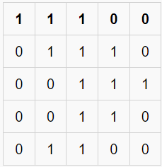
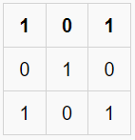
Convolutions
image
kernel

Slide 61
Convolutions
image
kernel

Slide 62
Convolutions
image
kernel

Slide 63
Convolutions
image
kernel

Slide 64
Convolutions
image
kernel

Slide 65
Convolutions
image
kernel

Slide 66
Convolutions
image
kernel

Slide 67
Convolutions
image
kernel

Slide 68
Convolutions
image
kernel

Slide 69
Convolutions
image
kernel

Slide 70

Convolutional Neural Networks
Image source: https://giphy.com/explore/convolutional-neural-network

Slide 71

What do these kernels learn?
Layer depth
Source: https://distill.pub/2017/feature-visualization/appendix/

Slide 72


Recurrent Neural Networks
Outputs go back and forth between neurons (loops exist in the graphs)
Approximates dynamical systems - Any time-based function - Any data that can be modelled as being “ordered”
Used often in time-series tasks like signal processing, natural language processing
Several types: Fully-connected RNNs, LSTMs, GRUs, reservoirs
An LSTM cell schematic. Adapted from: doi.org/10.4233/uuid:dc73e1ff-0496-459a-986f-de37f7f250c9
Echo state network schematic. Adapted from www.scholarpedia.org/article/Echo_state_network

Slide 73
Practical tips

Slide 74
How to train a NN – A pipeline (Jaeger, 2022)
1. A clear idea of the nature of the task. Inputs? Outputs? Underlying function? 2. Decide on a loss function. Categorization? CE? Regression? Quadratic?
3. Decide on a regularization method. L2 norm? Dropout? Early stopping?
4. Vector-encode inputs. Dimensionality reduction? Ratio of dimension/data points?
5. Decide on architecture. Width/breadth? Activation functions? Output function? 6. Set up cross-validation routine. Simple cross-val? Early stopping? k-fold?
7. Train and test your model. Epochs? Learning rate? Optimizer?
8. Enjoy the power of neural networks!

Slide 75
Validation (Recap)
Split your training set into two! - New train set - Unseen-by-the-model “validation”set
Train Set
Test Set (unseen)

Slide 76
Validation (Recap)
Split your training set into two! - New train set - Unseen-by-the-model “validation”set - e.g. 80-20 split (Note: split ratio depends on the model, task and data)
Train Set
Validation Set
Test Set (unseen)
80%
20%

Slide 77
k-fold Cross-validation
Split training set into k-segments, iteratively train and validate with each segment.
- Accounts for irregularities in training set - “Gold standard” for evaluating generality of neural network models
Train Set

Slide 78
k-fold Cross-validation
Split training set into k-segments, iteratively train and validate with each segment.
- Accounts for irregularities in training set - “Gold standard” for evaluating generality of neural network models
e.g. k=5 (5-fold cross-validation)
Train Set
Train Set
Train Set
Train Set
Train Set

Slide 79
k-fold Cross-validation
Split training set into k-segments, iteratively train and validate with each segment.
- Accounts for irregularities in training set - “Gold standard” for evaluating generality of neural network models
e.g. k=5 (5-fold cross-validation)
Validation Set
Train Set
Train Set
Train Set
Train Set

Slide 80
k-fold Cross-validation
Split training set into k-segments, iteratively train and validate with each segment.
- Accounts for irregularities in training set - “Gold standard” for evaluating generality of neural network models
e.g. k=5 (5-fold cross-validation)
Train Set
Validation Set
Train Set
Train Set
Train Set

Slide 81
k-fold Cross-validation
Split training set into k-segments, iteratively train and validate with each segment.
- Accounts for irregularities in training set - “Gold standard” for evaluating generality of neural network models
e.g. k=5 (5-fold cross-validation)
Train Set
Train Set
Validation Set
Train Set
Train Set

Slide 82
k-fold Cross-validation
Split training set into k-segments, iteratively train and validate with each segment.
- Accounts for irregularities in training set - “Gold standard” for evaluating generality of neural network models
e.g. k=5 (5-fold cross-validation)
Train Set
Train Set
Train Set
Validation Set
Train Set

Slide 83
k-fold Cross-validation
Split training set into k-segments, iteratively train and validate with each segment.
- Accounts for irregularities in training set - “Gold standard” for evaluating generality of neural network models
e.g. k=5 (5-fold cross-validation)
Result = average over all validation passes
Train Set
Train Set
Train Set
Train Set
Validation Set

Slide 84


Training curves
Important to plot!

Slide 85
Training curves
Important to plot!(!!!!)

Slide 86
Training curves
Important to plot!(!!!!)
Shows if and how fast your model is learning on task-relevant metrics - e.g. loss, accuracy, AUC, F1 score - Plot scores over training epochs

Slide 87
Training curves
Important to plot!(!!!!)
Shows if and how fast your model is learning on task-relevant metrics - e.g. loss, accuracy, AUC, F1 score - Plot scores over training epochs
May indicate potential over and underfitting

Slide 88

Reading training curves
If validation loss > training loss then often the model is good!
Low loss == Better

Slide 89

Reading training curves
If validation loss >> training loss then often the model is overfitting
Low loss == Better

Slide 90

Reading training curves
If validation loss ~ training loss then often the model is underfitting
Low loss == Better

Slide 91

Reading training curves
If validation loss < training loss something is very wrong/totally expected!
Low loss == Better

Slide 92

Parallelization: Speeding up NNs
Main math operation in NNs: - Matrix-vector multiplications - Element-wise nonlinear activation functions
Parallelization can be used to massively speed up learning and deployment! - Multi-core CPUs - Graphics processing units (GPUs) - Tensor processing units (TPUs) - FPGAs
Image from https://cloud.google.com/blog/products/ai-machine-learning/an-in-depth-look-at-googles-first-tensor-processing-unit-tpu

Slide 93
Frontiers
Deep learning - Models with hundreds of layers, billions of weights - Transformers, generative adversarial networks, autoencoders - AutoMLs: a tool to automatically generate good ML models for a task
Explainable AI (XAI) - Explainable+interpretable models - Human-like and human-understandable reasoning
Reservoir computing - Echo state networks - Conceptors

